Slide 1
Kafka Connect

Slide 2
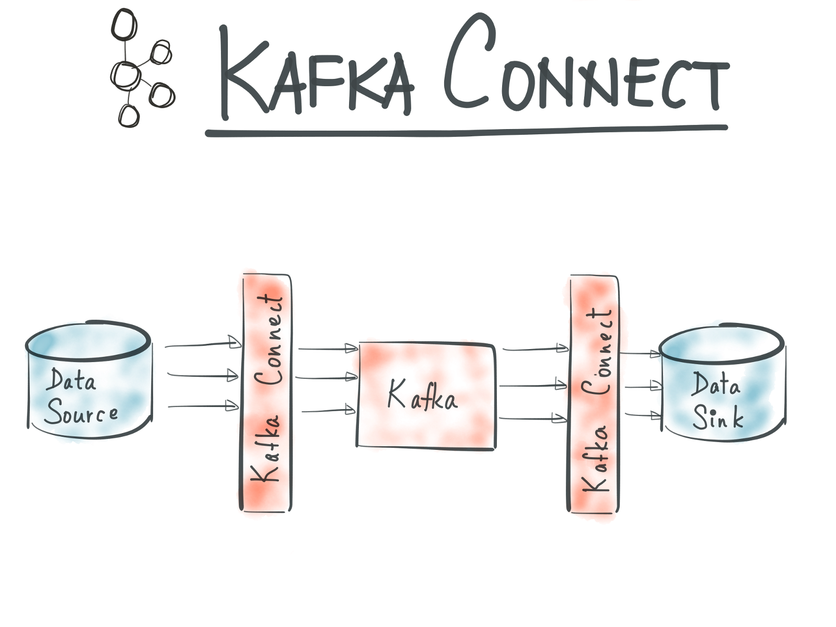

Slide 3
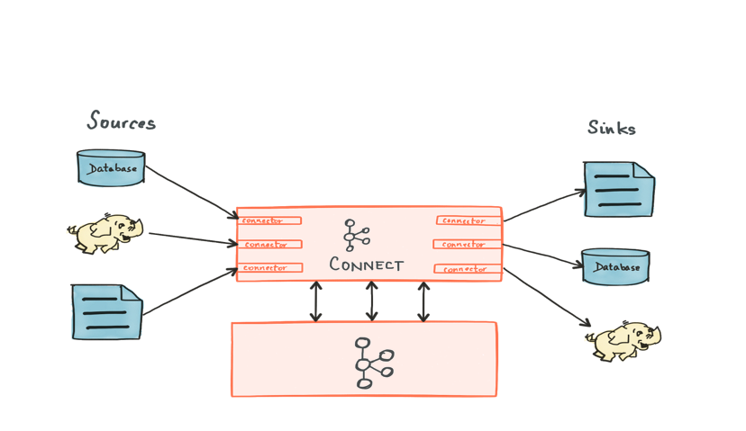

Slide 4


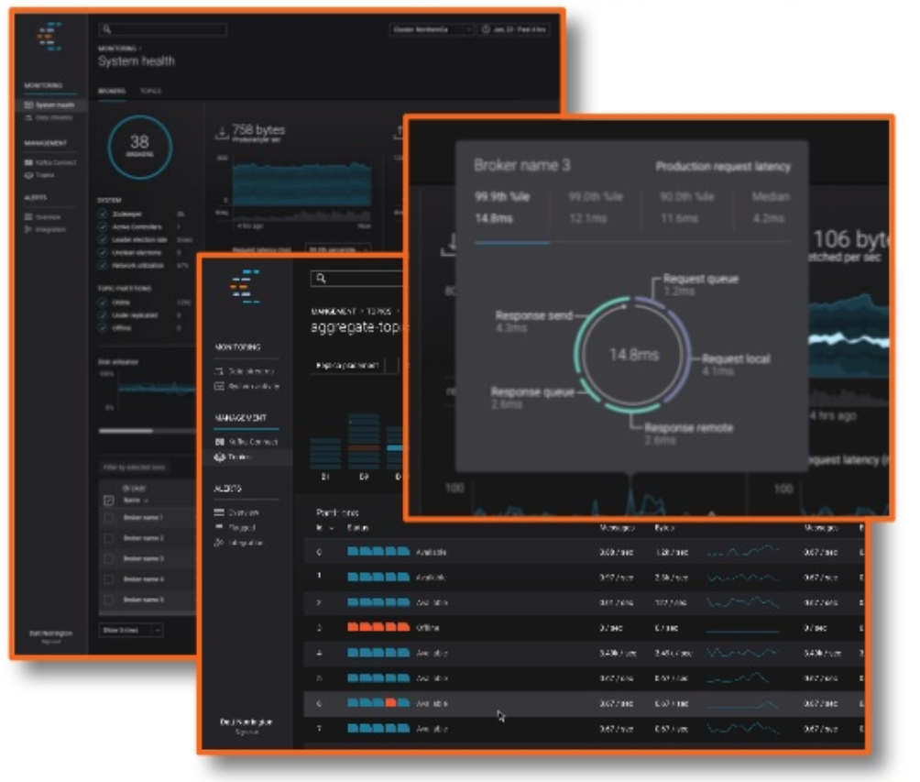
FileSource Connector
ElasticsearchSink Connector
connect-test topic
File containing
filesystem events
Confluent Control Center

Slide 5
Manage and monitor
Kafka and Kafka Connect
Kafka Connect
Runs FileSourceConnector
(which reads a local file)
Runs ElasticsearchSinkConnector
Kafka broker
Hosts topic
Stores Connect state
Target datastore
Visualize data

